Slide 1
RSM222 Management Accounting 1 Class 2: Cost Behaviours, Cost Flows and CVP Analysis
Elisa Zuliani

Slide 2
Learning Objectives of Class 2
Identify each of the three basic manufacturing cost categories.
Review schedule of cost of goods manufactured
Describe the cost classification used in making decisions: differential costs, opportunity costs and sunk costs
Explain variable, fixed, and mixed costs and the relevant range.
Apply the high-low method to determine the components of mixed costs.
Prepare a CVP income statement to determine contribution margin.
Key Takeaway: Changes in level or volume of activity should be correlated
with changes in costs.

Slide 3
Manufacturing Costs

Slide 4
Manufacuring Costs
Three broad categories:
Direct Materials – become an integral part of the integral part of the product and that can be physically and conveniently traced directly to it
Direct Labour - labour costs that can be easily traced to individual units of product.
Manufacturing Overhead - all costs of manufacturing other than direct material and direct labour
Indirect Material – materials used to support the production process e.g. cleaning supplies
Indirect Labour – wages paid to employees who are not directly involved in production work e.g. janitors, security guards

Slide 5
Classification of Costs
Direct Material
Direct Labour
Manufacturing Overhead
Prime Cost
Conversion Cost

Slide 6
Non -Manufacuring Costs
Marketing or Selling Costs: Costs necessary to get the order and deliver the product
Administrative Costs: All executive, organizational, and clerical costs

Slide 7
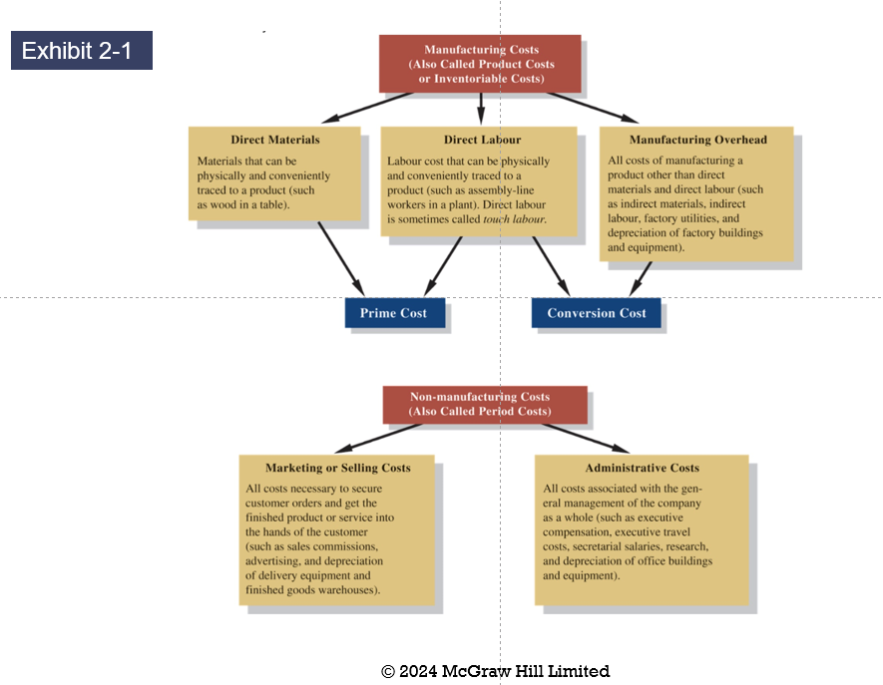
Summary of Cost Terms

Slide 8


Let's practice….
Using the week 1 class handout, provide examples of the various costs

Slide 9

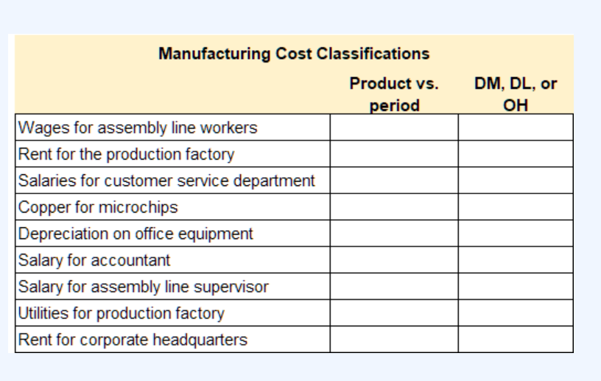

Product vs. Period Costs
Product Costs
Manufacturing costs
Costs relate directly to making the product
Cost assigned to inventory
Period Costs
Non-manufacturing costs
Costs not directly elated to making the product
Cost expensed when incurred

Slide 10
Cost of Goods Manufactured

Slide 11
Balance Sheet
Merchandiser
Current Assets
Cash
Receivables
Prepaid Expenses
Inventory
- Merchandise
Manufacturer
Current Assets
Cash
Receivables
Prepaid Expenses
Inventory
- Raw Materials
- Work in Process (WIP)
- Finished Goods

Slide 12
Income Statement

Slide 13
Schedule of Cost of Goods Manufactured
Calculates the cost of raw material, direct labour and manufacturing overhead used in production.
Calculates the manufacturing costs associated with goods that were finished during the period.

Slide 14
Product Cost Flows
As items are removed from raw materials inventory and placed into the production process, they are called direct materials.

Slide 15
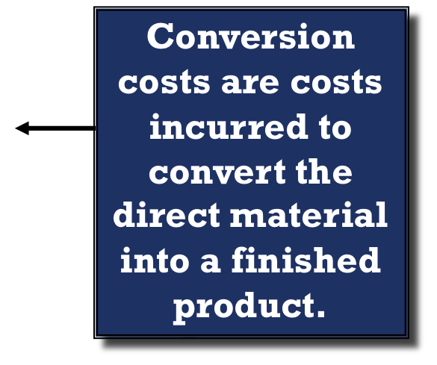
Product Cost Flows

Slide 16
Product Cost Flows
All manufacturing costs incurred during the period are added to the beginning balance of work in process.

Slide 17
Product Cost Flows
Costs associated with the goods that are completed during the period are transferred to finished goods inventory.

Slide 18
Product Cost Flows

Slide 19
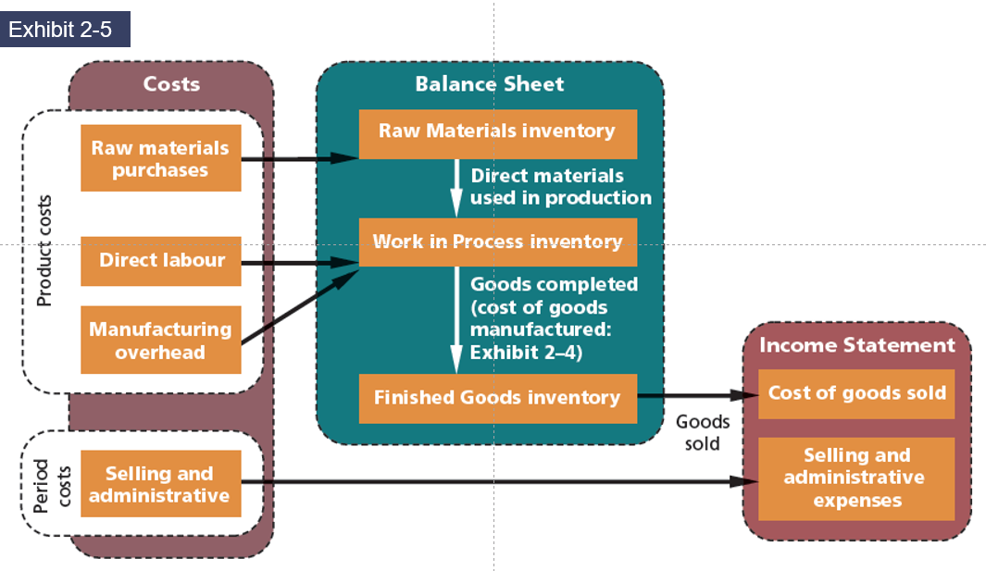
Manufacturing Cost Flows

Slide 20
Classification of Costs

Slide 21
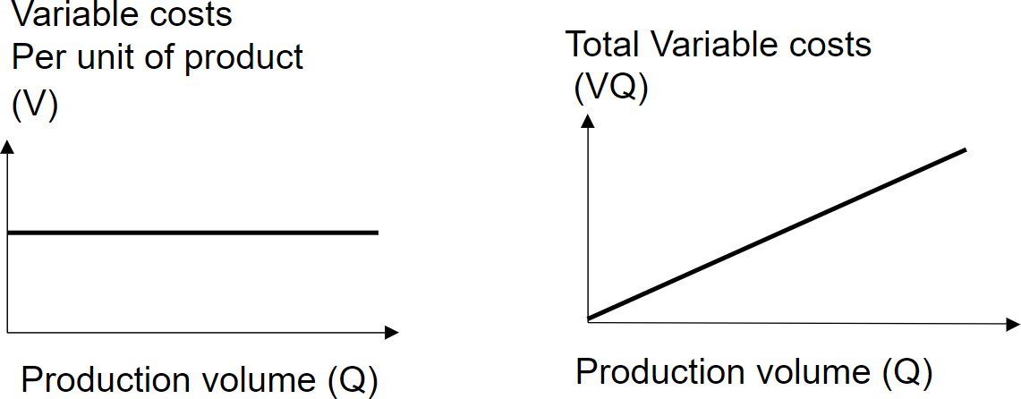
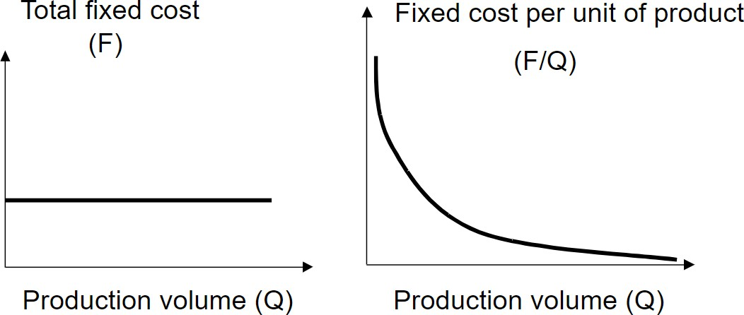
Class 1 “Recap”
Make sure you understand this concept
Variable Costs
Variable Costs vary in total directly and proportionately with changes in the activity level.
Variable costs remain the same per unit at every level of activity.
Fixed Costs
Costs that remain the same in total regardless of changes in the activity level within a relevant range.
Fixed cost per unit cost varies inversely with activity: As volume increases, unit cost declines, and vice versa.

Slide 22





True Variable Cost
The amount used during a period varies in direct proportion to the level of production activity.
Types of Fixed & Variable Costs
Step Variable Cost
The cost of a resource that is obtainable only in large amounts and the increase or decrease only in response to fairly wide changes in activity.
Committed Fixed Costs
Cannot be reduced easily without significantly impacting operations and objectives.
Discretionary Fixed Costs
Can be reduced more easily in the short run without significant changes to operations and objectives.
True Variable Cost
The amount used during a period varies in direct proportion to the level of production activity.
Step Variable Cost
The cost of a resource that is obtainable only in large amounts and the increase or decrease only in response to fairly wide changes in activity.
Why is this important? What are some examples?

Slide 23

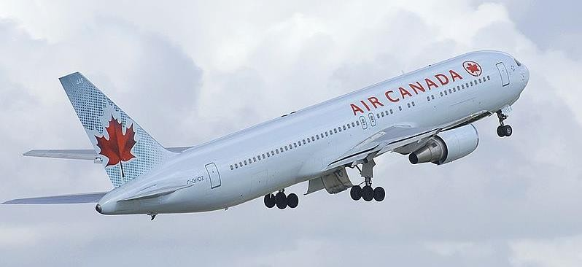
True Variable Cost
The amount used during a period varies in direct proportion to the level of production activity.
Concept Application
Step Variable Cost
The cost of a resource that is obtainable only in large amounts and the increase or decrease only in response to fairly wide changes in activity.
To be profitable, how many seats need to be sold on an Air Canada Flight going from Toronto to Paris?
What kind of Info would we need?

Slide 24



The Linearity Assumption and the Relevant Range
Economist’s Curvilinear Cost Function
A straight line closely approximates a curvilinear variable cost line within the relevant range.
Relevant
Range
Total Cost
Accountant’s Straight-Line Approximation (constant unit variable cost)
Activity

Slide 25



Mixed Costs
Costs that have both a variable element and a fixed element.
Change in total but not proportionately with changes in activity level.
Ex. Utilities including electricity, water and natural gas
Who remembers those infamous texts about running out of data?

Slide 26
Mixed Costs
For purposes of cost-volume-profit analysis, mixed costs must be classified into their fixed and variable elements.
High-Low Method uses total costs incurred at high and low levels of activity to classify mixed costs into fixed and variable components.
Difference in costs between high and low levels represents variable costs,
since only variable-cost element can change as activity levels change.
Steps:
Find the high point and the low point
Find the variable rate
Find the fixed cost
Remember Y = mx + b?
Total Cost = VC per Unit * Units + Fixed Costs

Slide 27

High-Low Example (Source: Corporate Finance Institute)
The manager of a hotel would like to develop a cost model
to predict the future costs of running the hotel.
The only available data is the level of activity (number of guests) in a given month and the total costs incurred in each month.
He anticipates that the number of guests in September will be 3,000. What is the expected cost?
Month | Guests | Cost
January | 1,500 | $ 143,000
February | 2,300 | $ 203,100
March | 1,000 | $ 105,450
April | 4,323 | $ 454,225
May | 4,545 | $ 371,225
June | 3,541 | $ 296,225
July | 4,312 | $ 353,945
August | 2,143 | $ 191,237
September | 3,000
$
/ = a ‘ bx
Y = Total mixed costs
a = total fixed costs
B = variable cost per unit of activity
X = the level of activity.
Fixed Costs
# units

Slide 28
High-low Example (Source: Corporate Finance Institute)
Variable Costs
= ($371,225 - $105,450)/(4,545 – 1000)
= $74.97 per guest Fixed Cost
=$371,225 – $74.97*4,545
= 30,480
 | Month | Guests | Cost
Low | March | 1,000 | $ 105,450
High | May | 4,545 | $ 371,225
= $30,480 + 74.97/guest
= $30,480 + 74.97 * 3,000
= $255,390
Expected Cost
Too Simple? Is Regression Better?

Slide 29
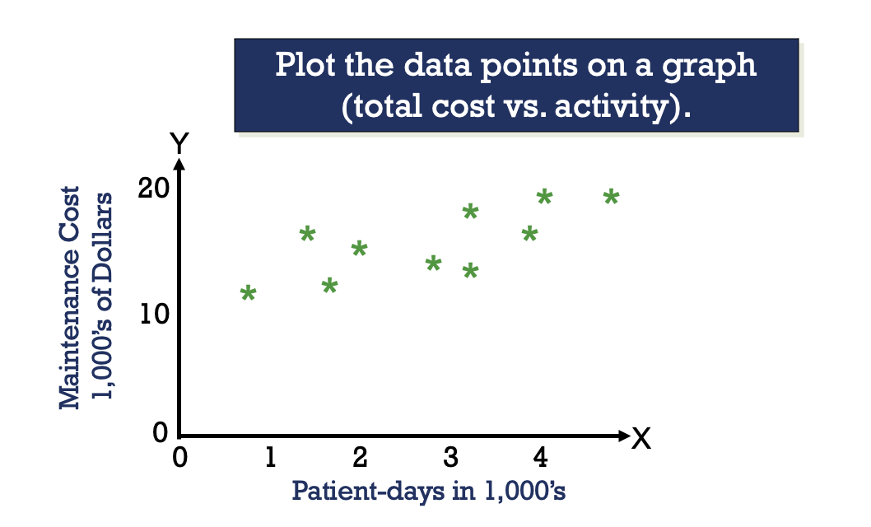
Another Approach to Estimate – Scattergraph Plots – Part 1

Slide 30
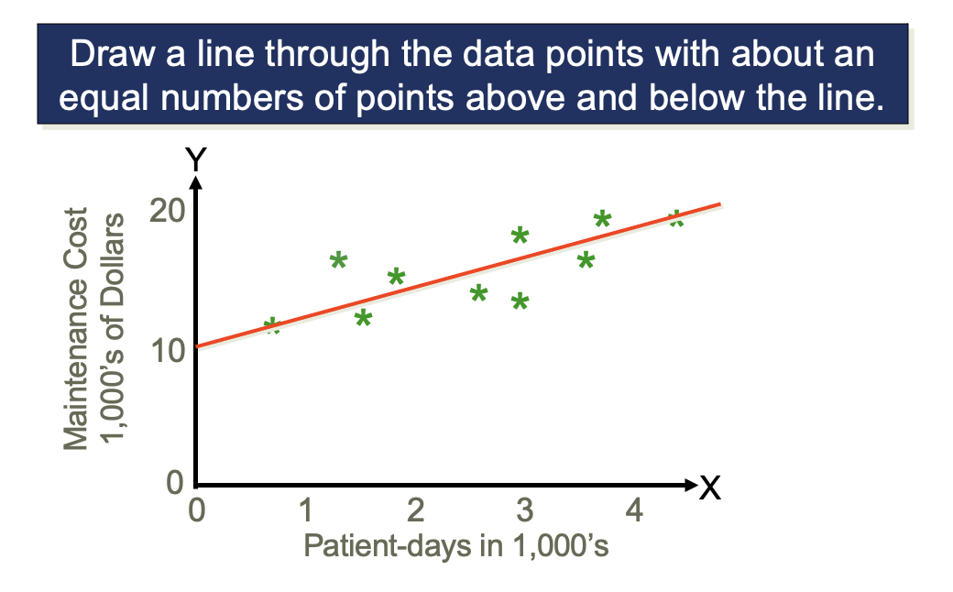
Another Approach to Estimate – Scattergraph Plots – Part 2

Slide 31
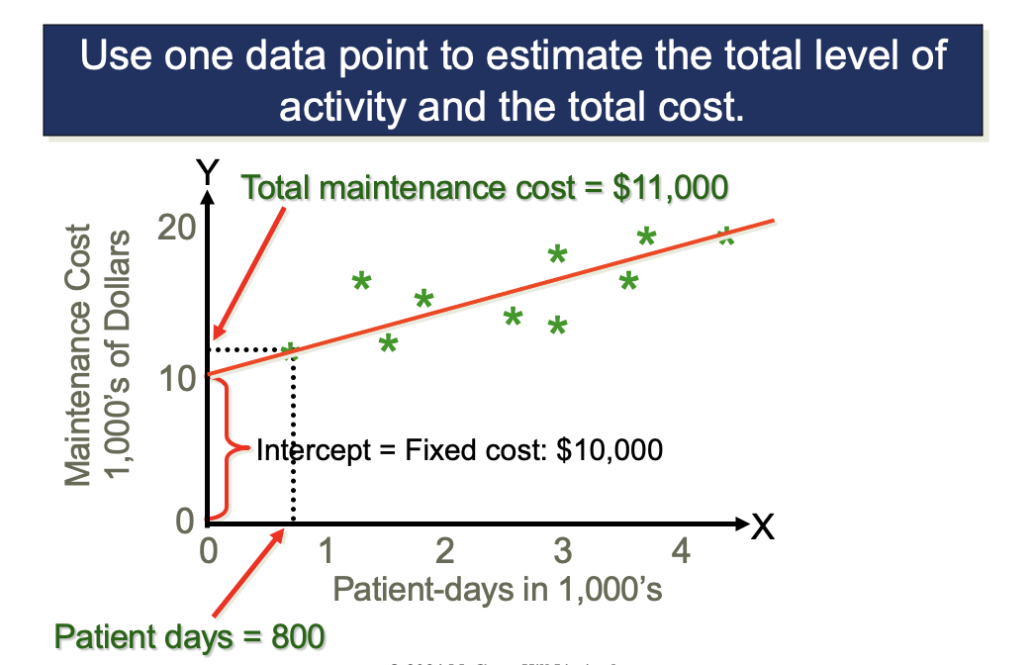
Another Approach to Estimate – Scattergraph Plots – Part 3

Slide 32
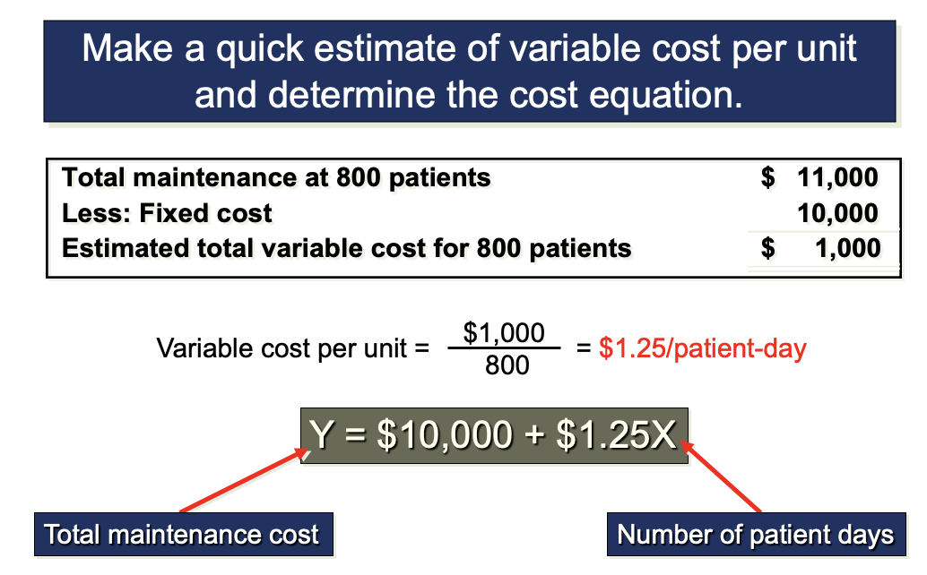
Another Approach to Estimate – Scattergraph Plots – Part 4

Slide 33
Another Approach to Estimate – Least-Squares Regression
The scattergraph and the high-low method provide slightly different estimates of the fixed and variable cost components of a mixed cost
This is to be expected because each method uses a different number of data points to provide estimates
Least-squares regression provides the most accurate estimate because it uses all the data points. This method is discussed in the appendix to this chapter

Slide 34
Regression Analysis
Ordinary least squared (OLS) regression
Total cost function:
Unit variable cost
Fixed cost

Slide 35
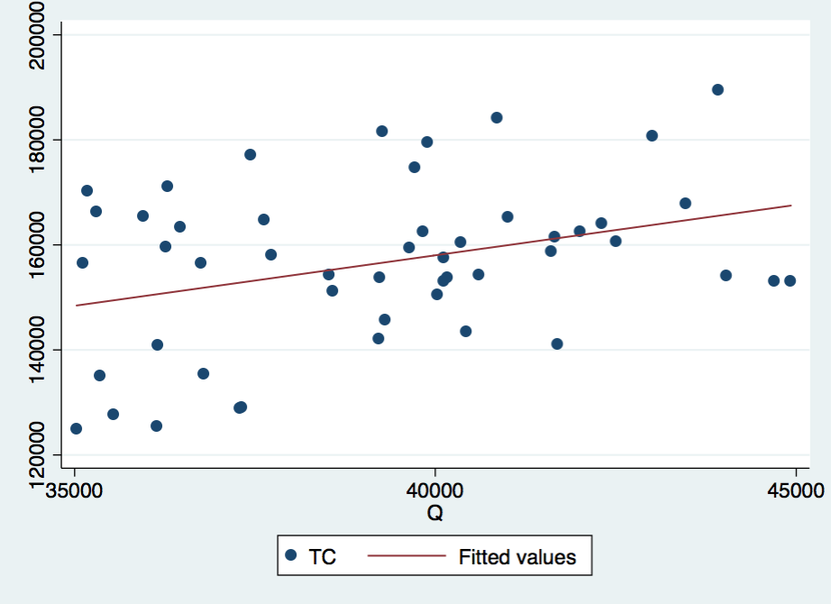
Regression Analysis
Strength
Rigorous
Uses all available data
Allows to control effects from other factors (using multivariate regression analysis)

Slide 36
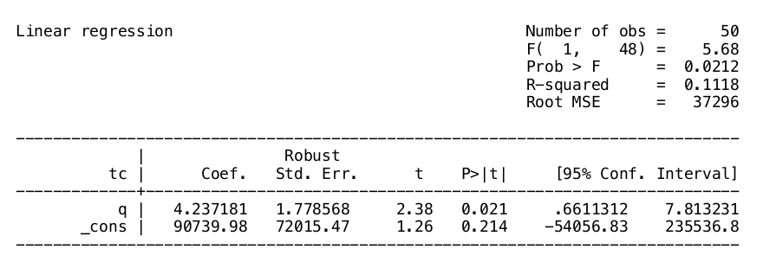
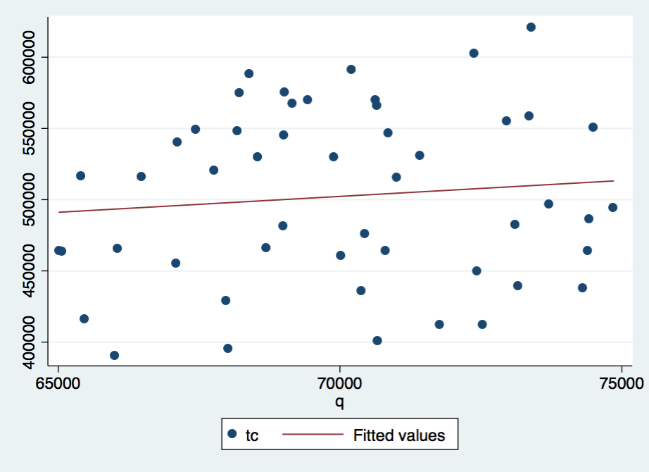
Regression Analysis
Q: Given the above regression result and the scatterplot, what is the firm’s total cost function? What would be the firm’s total cost when it produces 67,000 units? 100,000 units?

Slide 37
Problems with Cost Estimations
Is data representative?
Relationship between activity and cost must be linear
Changes in technology
Changes in prices
Cost recognition and activity must be in the same period
Identification of driver is sometimes difficult

Slide 38
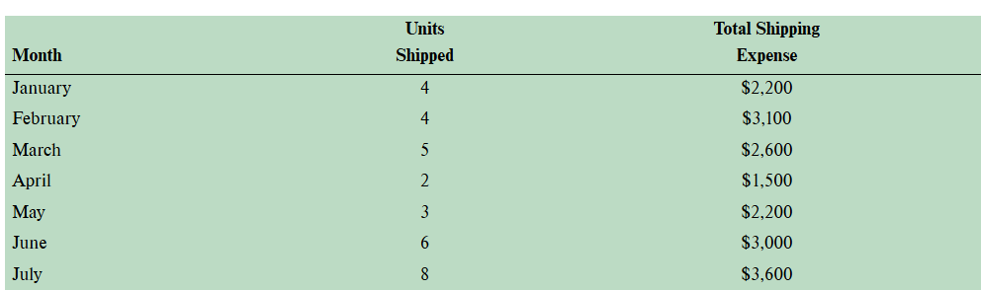
Let's practice…
Phillips Company manufactures air-conditioning units for commercial buildings and has noticed considerable variation in shipping expenses from month to month as per the data below:
Using the high-low method, determine the variable costs & the fixed costs
If 7 air conditioners are shipped in August, estimate the total shipping costs
If 10 air conditioners are shipped in October, estimate the total shipping costs

Slide 39
Contribution format

Slide 40
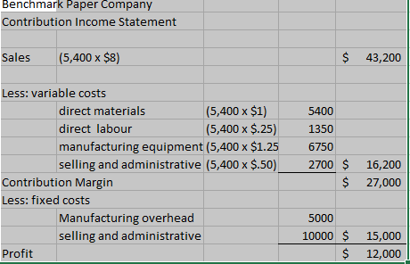
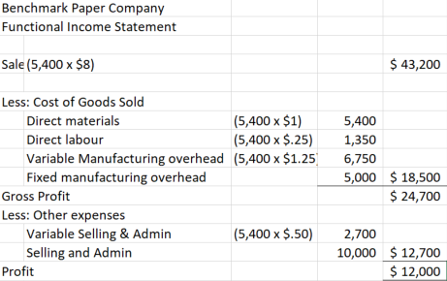
Contribution versus Functional Income Statement

Slide 41
Uses of the Contribution Format
The contribution income statement format is used as a tool for internal planning and decision making
This approach is used in later chapters for the following:
Cost-volume-profit analysis
2. Budgeting
3. Pricing
4. Use of scarce resources
5. Make or buy analysis

Slide 42
Classification of costs

Slide 43

Classification of Costs
Why is it important to have so many different classification for costs?

Slide 44
Classification of Costs
Differential Cost
Costs that differ between 2 alternatives between 2 alternatives.
Differential Revenue
Revenues that differ between 2 alternatives between 2 alternatives.
Incremental Cost
Increase in cost between 2 alternatives 2 alternatives.

Slide 45
Classification of Costs
Opportunity Cost
Potential benefit given up when one alternative is selected over another
Sunk Cost
Cost that has already been incurred and cannot be changed

Slide 46
Any Questions?

